Slide 1

For Insurance underwriting and engagement

Slide 2



Human API: Insurance Underwriting and Engagement
Make health data sharing easy for proposed insured and policy holders
Avoid invasive tests and long wait times for an APS
A simple user experience to search for and select health care providers
Consent and authorization ingrained in the experience (no HIPAA form required)
Easy authentication using patient portal credentials
Direct assistance with patient portal account creation or credential recovery
Applicants and policy holders can view their data with an optional Human API account
Live chat support for end users
Expedite underwriting with rich electronic health record data
Collect real-time medical records from over 70% of U.S. health care providers
Connected sources typically contain data from 2-3 physicians
Data includes codes such as ICD 9/10, SNOMED, RXNORM, NDC, LOINC and CPT
Data is normalized across health care providers and data sources
Review data via PDF or web based health timeline with the Human API Portal
Data made available within minutes of the user connecting
Collect data continuously from policy holders to better manage risk and improve engagement
Get started quickly with the
ability to integrate in the future
Use the cloud-hosted Human API Portal to invite users to connect and view data via PDF and web timeline (no integration)
Improve the experience with the ability to integrate consumer consent into e-application workflow
Ingest data (JSON) directly with API access
Power automated underwriting systems and rules using Human API EHR data

Slide 3
Human API Benefits to Insurance
Better Customer Experience: Reduce policy buying times for customers and minimize exposure to invasive exams required for underwriting.
Increase Revenue: Decrease time to issue and improve placement rates by collecting Electronic Health Record data in minutes.
Increase Underwriting Capacity: Reduce the time spent per case with searchable Human API data (PDF and web timeline), and build automated rules for straight through underwriting.
Reduce Cost: Minimize the amount of downstream underwriting requirements (APS, Fluids, Rx, etc.) and manual underwriting review of cases.
Manage Risk: Understand the health risk of your current policy holder portfolio to better manage capital reserves.
Engage: Allow your policy holders to own and view their data with MyHumanAPI personal health record to help them live a more health conscious lifestyle.

Slide 4
Insurance industry adoption of EHR Data
“When the EHR data was shared, we found the EHR either provided the same quality of data as the attending physician statement (APS) or it would have led to the same underwriting decision as the traditional process in most cases.”- The Actuary: EHRs for Individual Life Insurance Underwriting, October/November 2018, David Moore of Nationwide
“…the potential [for EHR data] is high in the near future for insurers to use EHRs for underwriting. First, it would improve the quality of underwriting by using verified medical data at the time of the application. Second, it would improve the user experience by reducing the burden placed on the users to answer questions.” - The Actuary: EHRs for Individual Life Insurance Underwriting, October/November 2018, David Moore of Nationwide
“EHRs, primarily gathered through patient portal technology, have the potential to fundamentally disrupt and improve the insurance risk assessment process.” - The Actuary: Picture of Health, October/November 2018, Chris Stehno, Managing Director, Deloitte Consulting
“Affordable instant access to electronic health records on most applicants is another potential game changer.” - LOMA Resource Magazine, October 2018, Life Underwriting Trends to Watch, Hank George

Slide 5
Human API End-User Conversion Funnel
Total population of insurance applicants and policy holders
With online patient portal access
EHR patient portals in Human API network
Human API Connected Users
Willing and able to share data through Human API with patient portal credentials
60%
25%
100%
55%
75%

Slide 6
Example Human API Portal Underwriting Workflow (Individual Life/Disability Insurance)
Step 1
Step 2
Step 3
Step 4A
Step 5
Step 6
Step 7
Agent/Applicant Engage
E-Med App
Rx, MIB & MVR data ordered
Info passed to UW →
UW populates HAPI link. UW sends link to Proposed Insured
Fluids ordered for select age and face amounts
If more information is required →
APS Ordered
Medically Approved or Decline
Telemed Interview
Paper Para-med Interview
Step 2: Application completed and submitted, including info on medical providers
Applicant connects data
EHR info collected from HAPI and analyzed
Step 4b
UW will save file, PDF and add it to record in automated underwriting system

Slide 7
Common Questions

Slide 8
What conversion rate can we expect?
  With a successful deployment, carriers can expect a conversion rate of 20-30%.
Does Human API integrate with any e-app vendors?
  Yes. Human API has integration available with Ebix and iPipeline.
How long does it take end-users to share their data through Human API?
  95% of users will connect a data source in less than 5 minutes.
What if end-users don’t know their patient portal credentials?
  Human API helps end-users set up their patient portal credentials and recover their username and/or password if they don’t remember them.
How quickly do we get access to the data?
  After a user authenticates, the data is typically made available within minutes.
Can an end-user continuously share their data? Or, is it a one-time pull?
  A policy holder can decide to share a one-time snapshot of their data, or provide continuous access.
Does Human API help with training underwriters, distribution partners and/or agents?
  Yes. Human API will help train agents and underwriters on how to use Human API to collect health information from end-users.
What data can we expect to receive?
  Human API returns all data that’s typically found in a medical record. In some cases, clinical notes are also available. Human API returns data from all physicians associated with the selected health care provider (includes 2-3 physicians on average).
Do you have sample data we can review?
  Yes, Human API has over 200 de-identified EHR records available for review. Ask your Human API contact to learn more.

Slide 9
Platform Overview

Slide 10
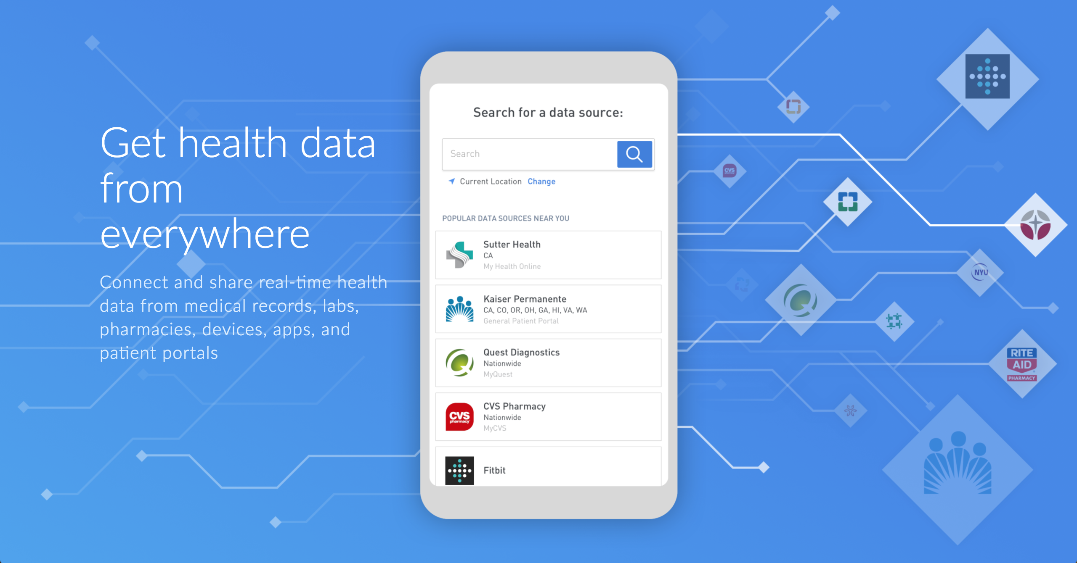

Slide 11
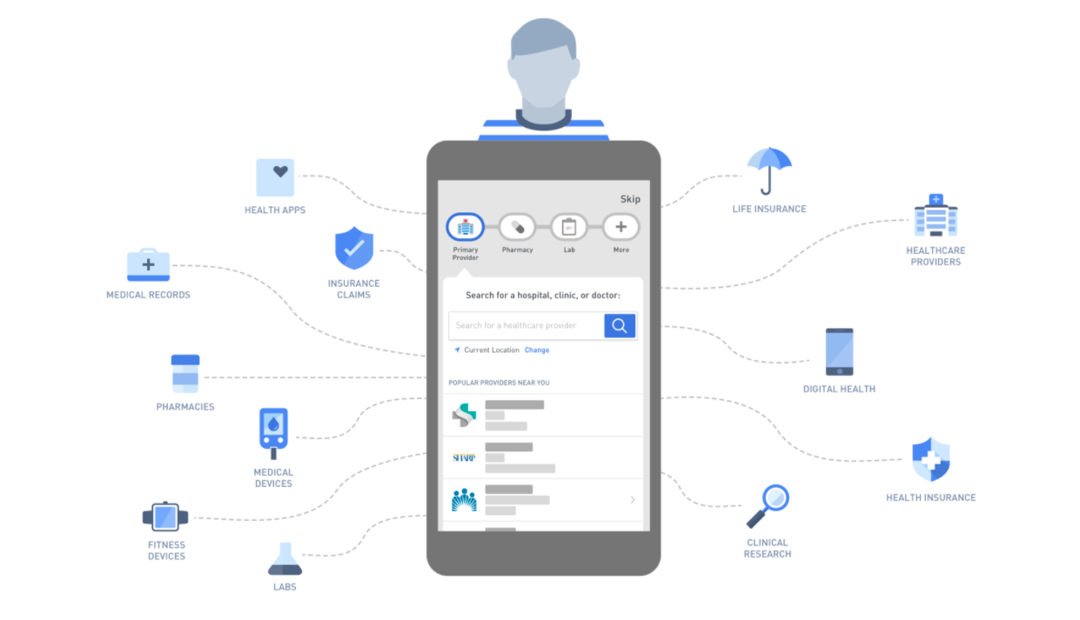
Human API: Who We Are
Human API empowers applicants and policy holders to quickly share their electronic health data with insurance carriers
Health apps
Life insurance
Healthcare providers
Medical records
Insurance claims
Pharmacies
Digital health
Medical devices
Health insurance
Fitness trackers
Clinical research
Labs

Slide 12
Human API solves 3 big problems for its customers
Enable consumers to connect
their health data
A simple user experience to search for and select your health data sources
Consent and authorization ingrained in the experience
Requires consumers to authenticate using their patient portal credentials
Assists users with direct links to recover passwords or register with source systems
Real-time synchronization status
Optional registration with Human API to view retrieved health data
Optional live chat support
Manage the world’s largest
health data network
Reach into 230M unique lives
Over 35,000 integrated data sources
Over 600,000 unique providers
8 of the top 10 EHRs (e.g. Epic, Cerner)
Includes doctors, clinics, locations, health systems, clinics, pharmacies, labs, Medicare, health, wellness & fitness devices, and genetics
Underlying data source integrations connect with patient portals, FHIR APIs, etc.
New integrations being added every month
Deliver structured longitudinal medical data in near-real time
Non-standard, semi-structured data from source systems gets processed and converted into clean programmatically accessible data
Data processing structures, normalizes, standardizes, and enriches data
Resulting format is a FHIR-inspired proprietary Human API ontology
Data access via Human API Enterprise Portal, API, or out-of-band in CSV and/or PDF formats

Slide 13
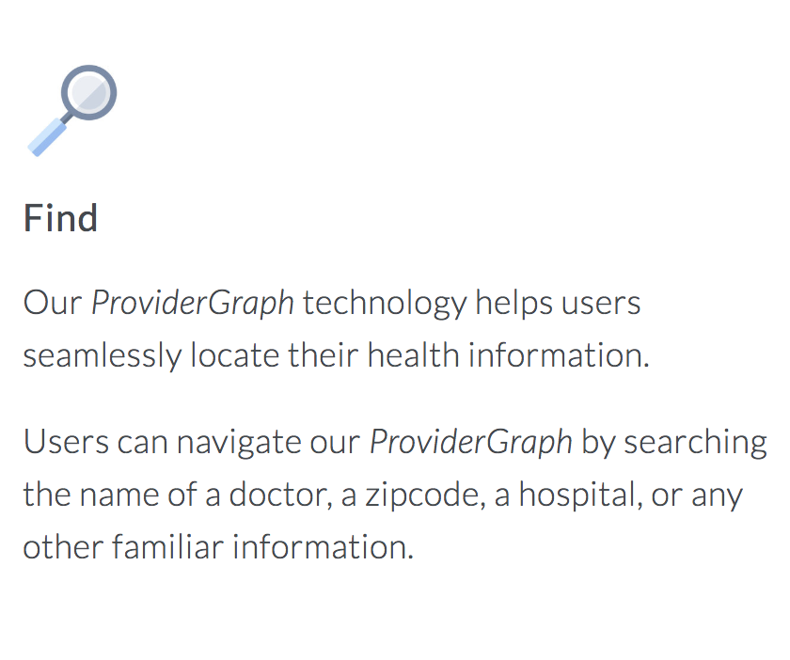
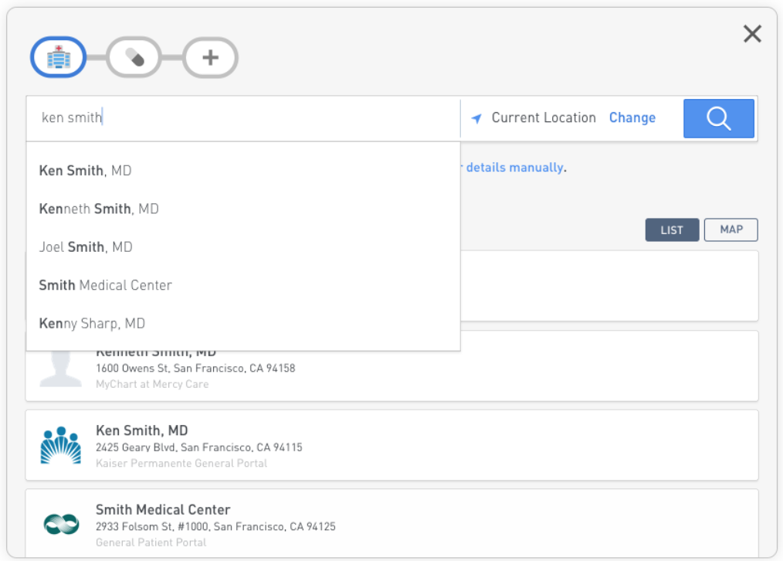
Human API: How it works

Slide 14
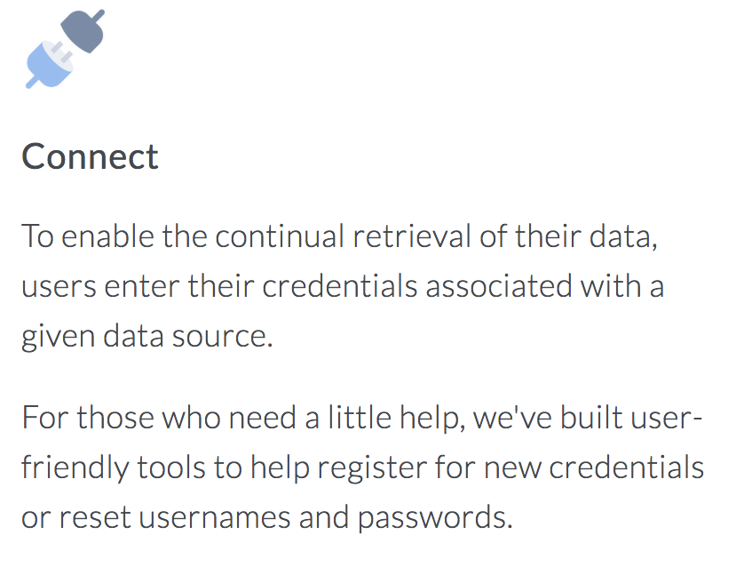
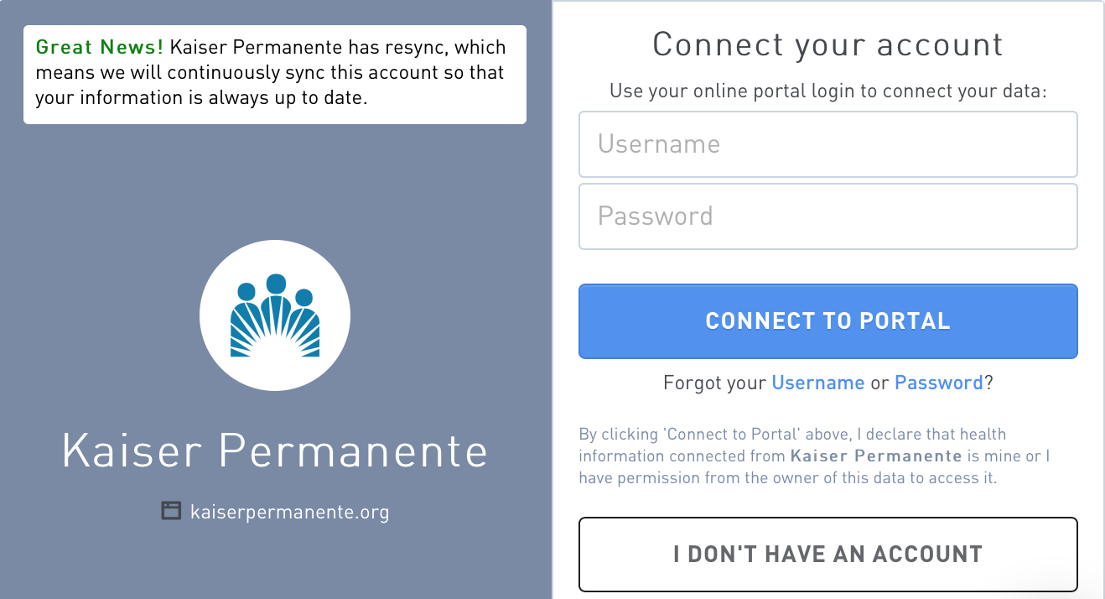
Human API: How it works

Slide 15
Data Network

Slide 16
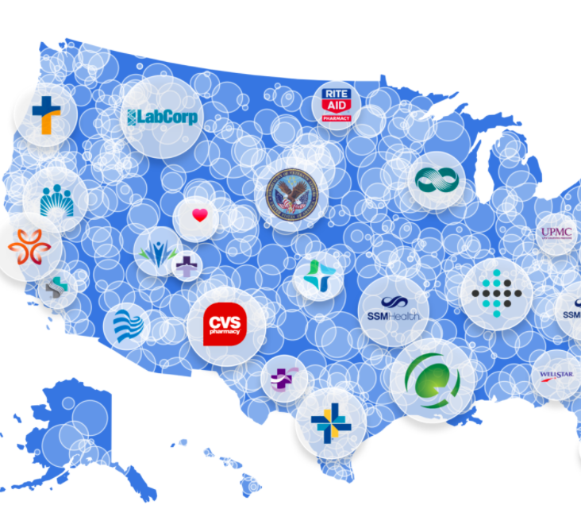
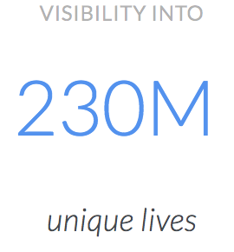
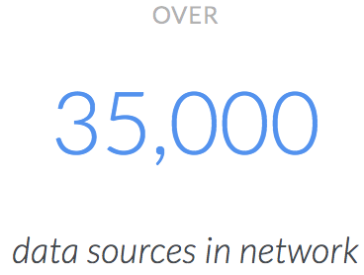
Our Data Network:
We've created the world's largest real-time data network with coverage that is broader and deeper than anything else in the industry. Our network enables users to find their health and wellness data, no matter where it's originally stored.

Slide 17




Available data sources
Category | Description | Data types | Examples
Healthcare Provider | Providers, health systems, doctors, etc. (e.g. using EHR systems) | Doctor visits, conditions, medications, procedures, test results, etc. | Mount Sinai, Kaiser, Dr. Smith, Family Orthopedic Clinic
Pharmacy | National pharmacies providing prescription medications to their customers | Medications | CVS, Walgreens, Rite-Aid
Lab | National independent laboratories | Test results, vitals | Quest Diagnostics, LabCorp
Insurance | Medicare only (roadmap to add private insurers) | Part A, B, & D | Medicare/CMS

Slide 18
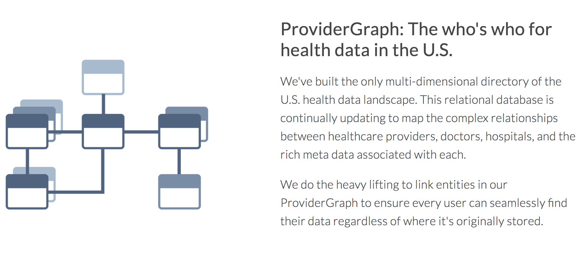

Slide 19
Data Overview

Slide 20
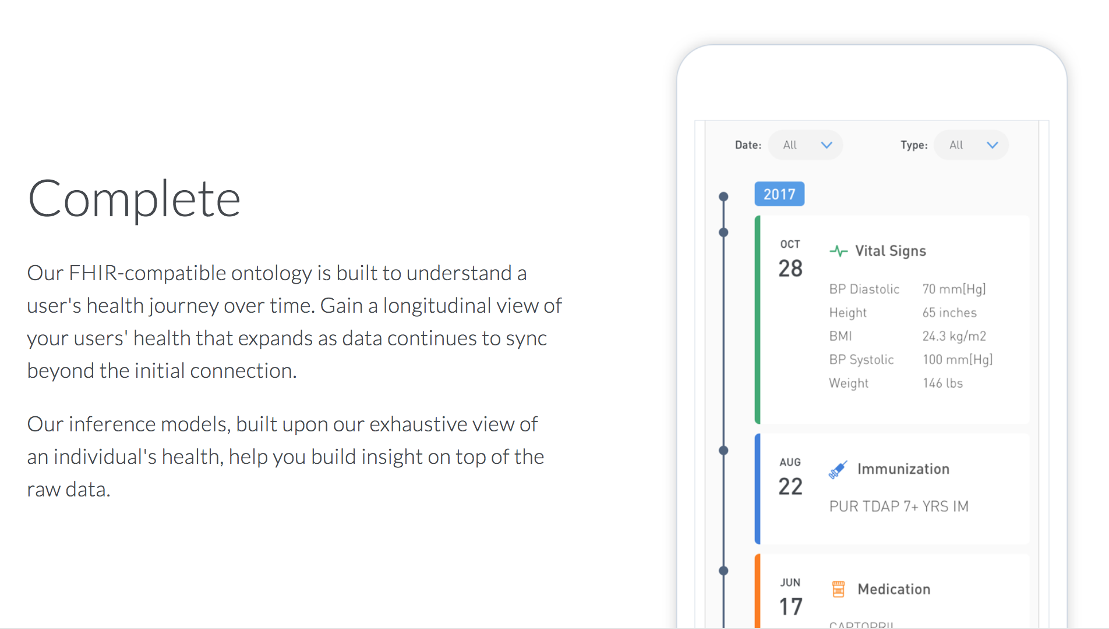

Slide 21
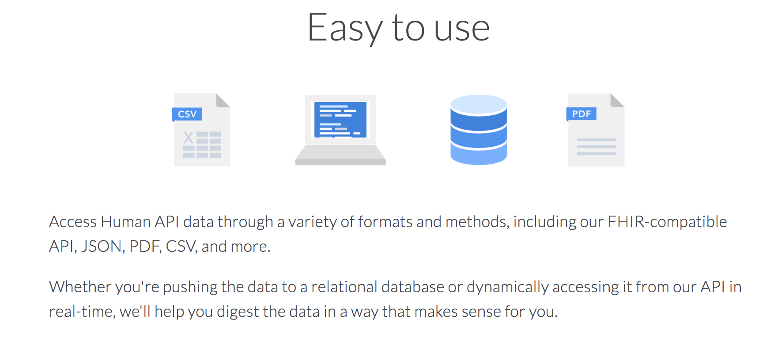

Slide 22
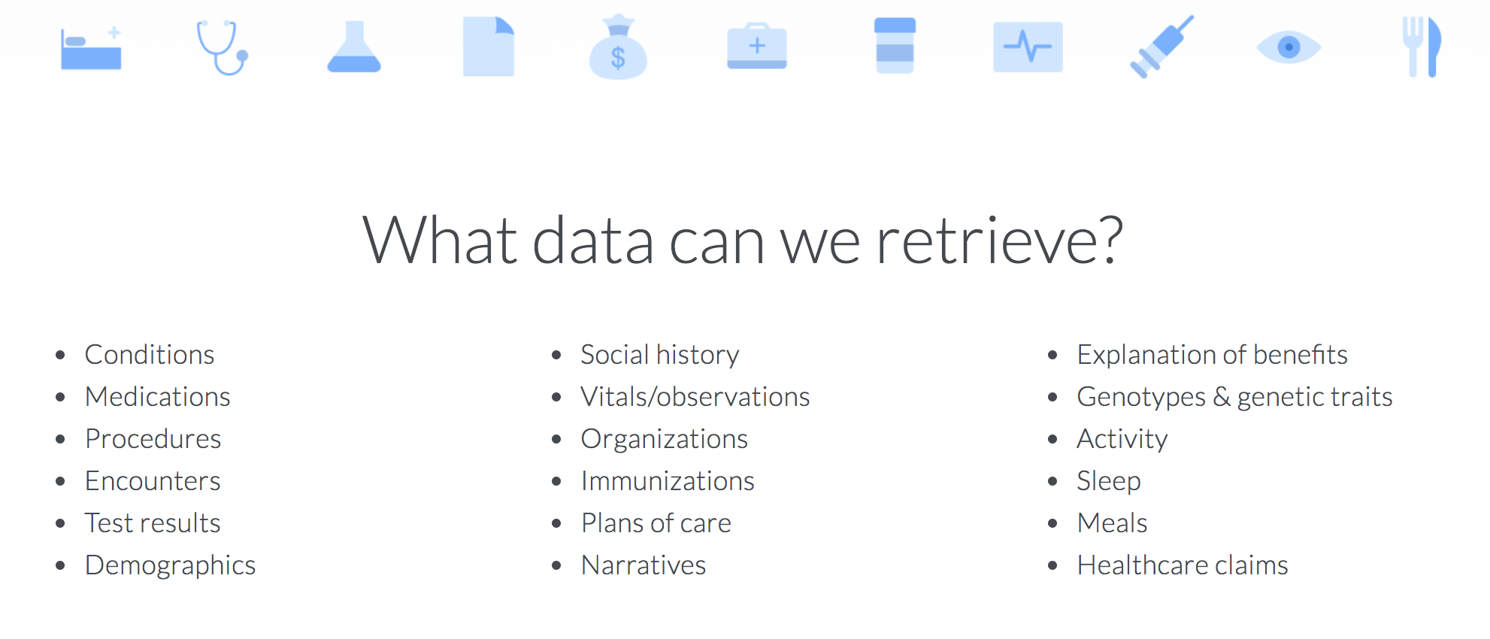

Slide 23
Available data retrieval options
 | Description | Frequency | Considerations
Continuous synchronization | Upon successful user authentication, Human API will initially retrieve a user’s current and historic data. It will then continuously poll the user’s data source(s) for updated information and notify the customer when new data is available. | Monthly (weekly may be available upon request) | “Fresh” patient registry always containing the latest information about a user Continuously qualify users into new studies based on new information from a user’s EHR Potential to pass a “connected” trial participant to a site to support virtual/connected trials
One-time retrieval | Upon successful user authentication, Human API will retrieve a user’s current and historic data once. | Once | Snapshot-in-time typically used to make a decision and not re-visit Inclusion/exclusion for a single clinical study

Slide 24
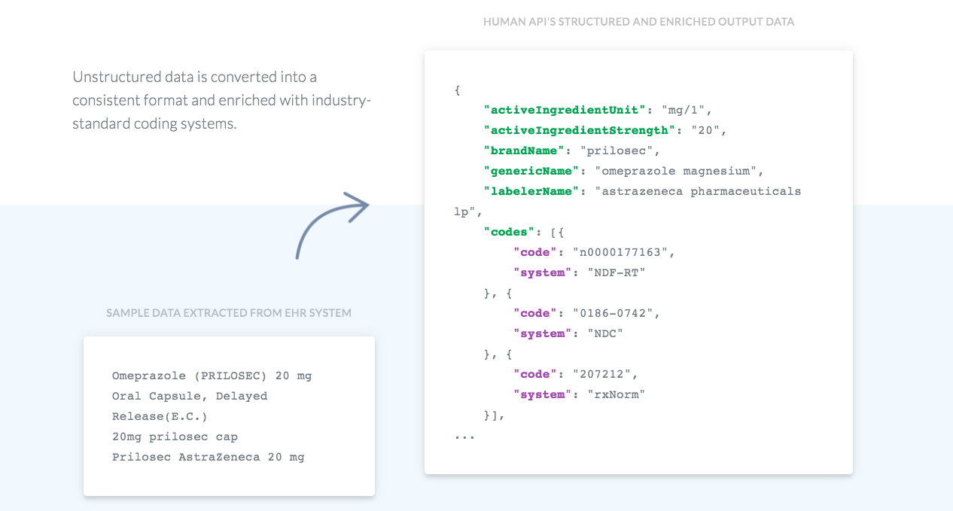
Health Data Normalization and Enrichment
Example API Output

Slide 25
Data Delivery Options
 | Enterprise Portal | API | CSV | PDF
Availability | Available by default | With application integration only | Out-of-band (optional) | Out-of-band (optional)
Description | Interactive web/mobile timeline with filtering, as well as downloadable PDF). | Hierarchically-structured raw data (e.g. JSON); separate API endpoints for each top-level data elements | Comma-Separated Value (CSV) formatted files, each representing top-level data elements (e.g. medications, conditions, etc.) and associated codes | Human-consumable PDF containing highlights of connected data (note: doesn’t include codes or all fields); sections for each of the top-level data elements
Typical use | Operational use, human analysis (e.g. provide to internal stakeholders on a user-by-user basis) | Programmatic (e.g. presenting data back within an application or ingesting into data pipeline) | Machine or human analysis, data warehousing (e.g. import into spreadsheets or relational database) | Operational use, human analysis (e.g. provide to end-users or internal stakeholders)
Level of effort | None | Medium | Low | Low
Frequency of data delivery | Near-real time (e.g. as data becomes available it is presented) | Near-real time (e.g. as data becomes available, using webhook notifications) | Typically weekly | Customer: Typically weekly End-user: As data becomes available
Delivery channel | HTTPS | HTTPS | Typically SFTP | Customer: Typically SFTP (or via Enterprise Portal) End-user: MyHumanAPI
*To view Human API reference documentation click here

Slide 26
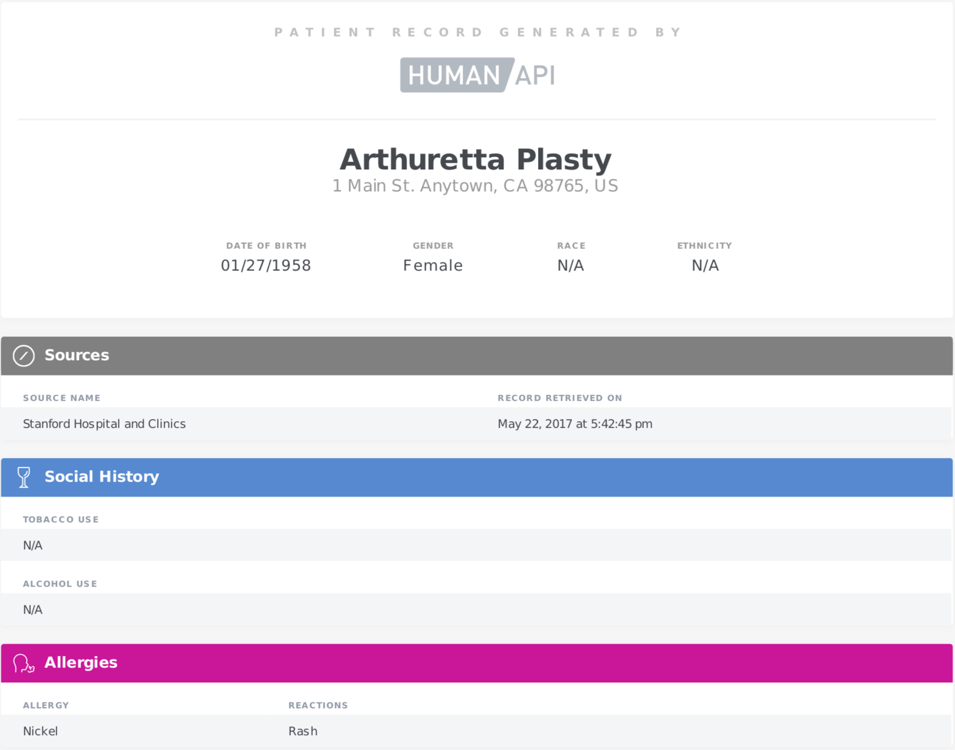
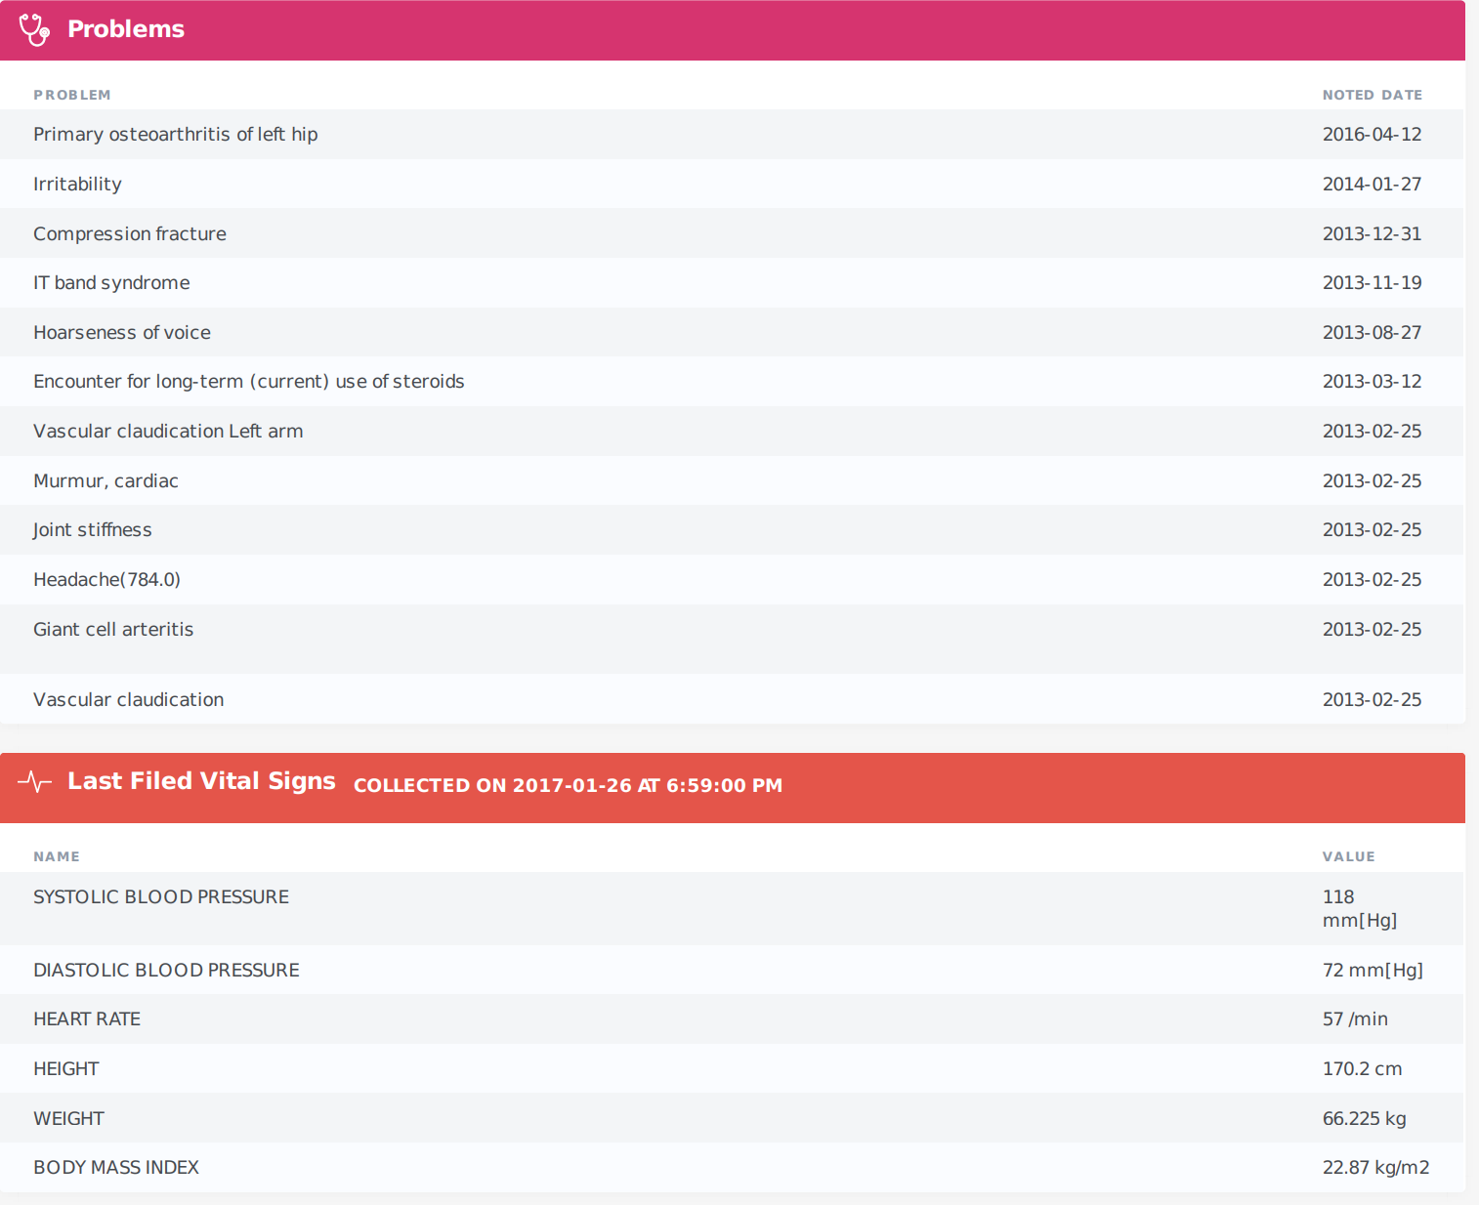
Human API Data: PDF Output

Slide 27
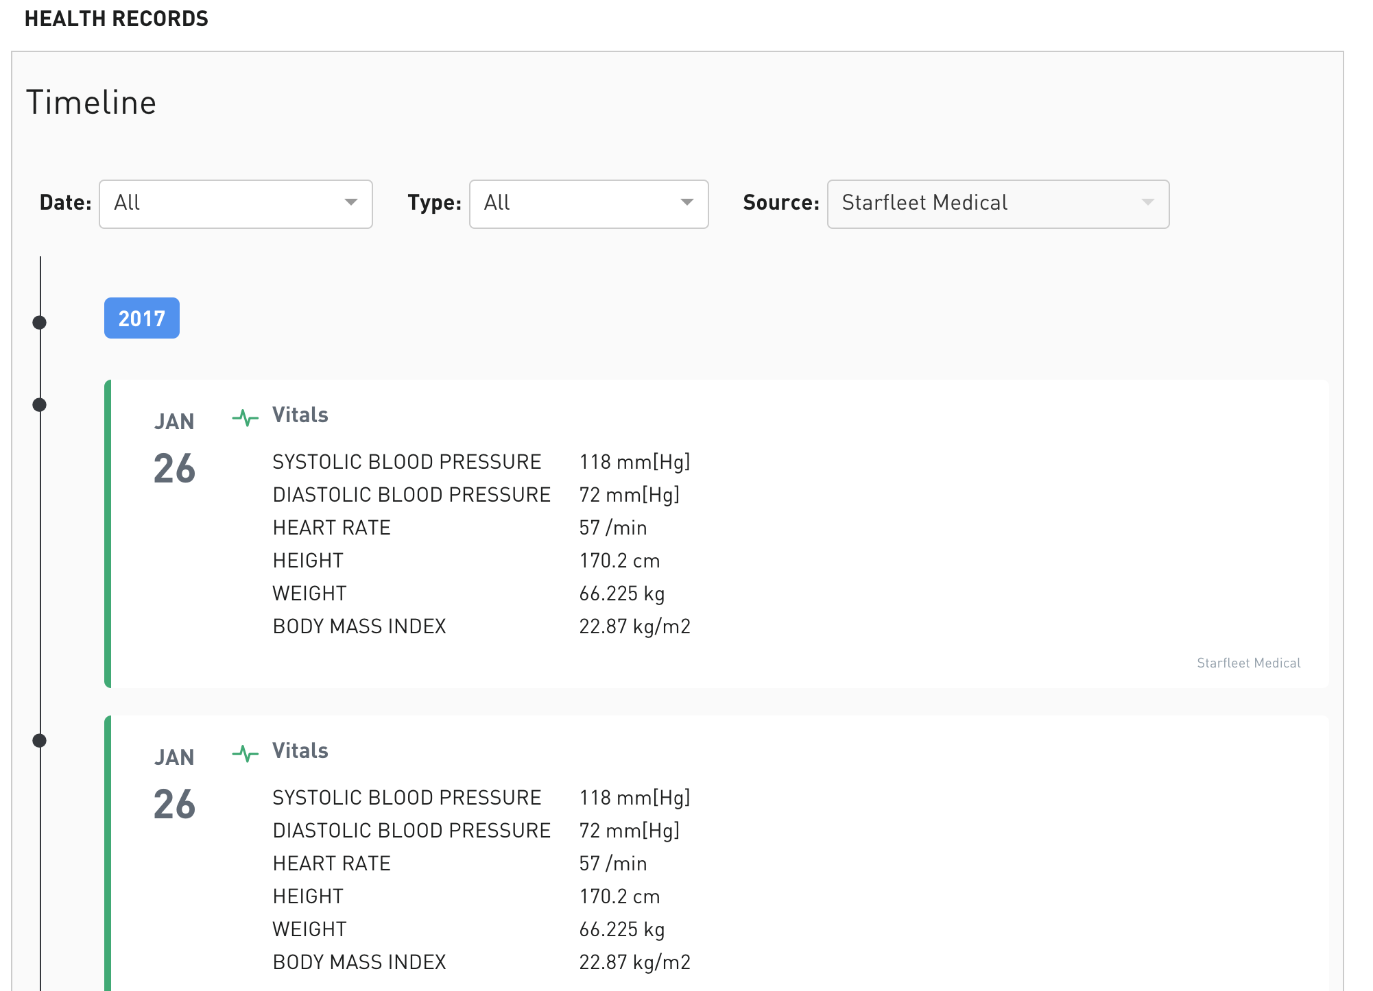
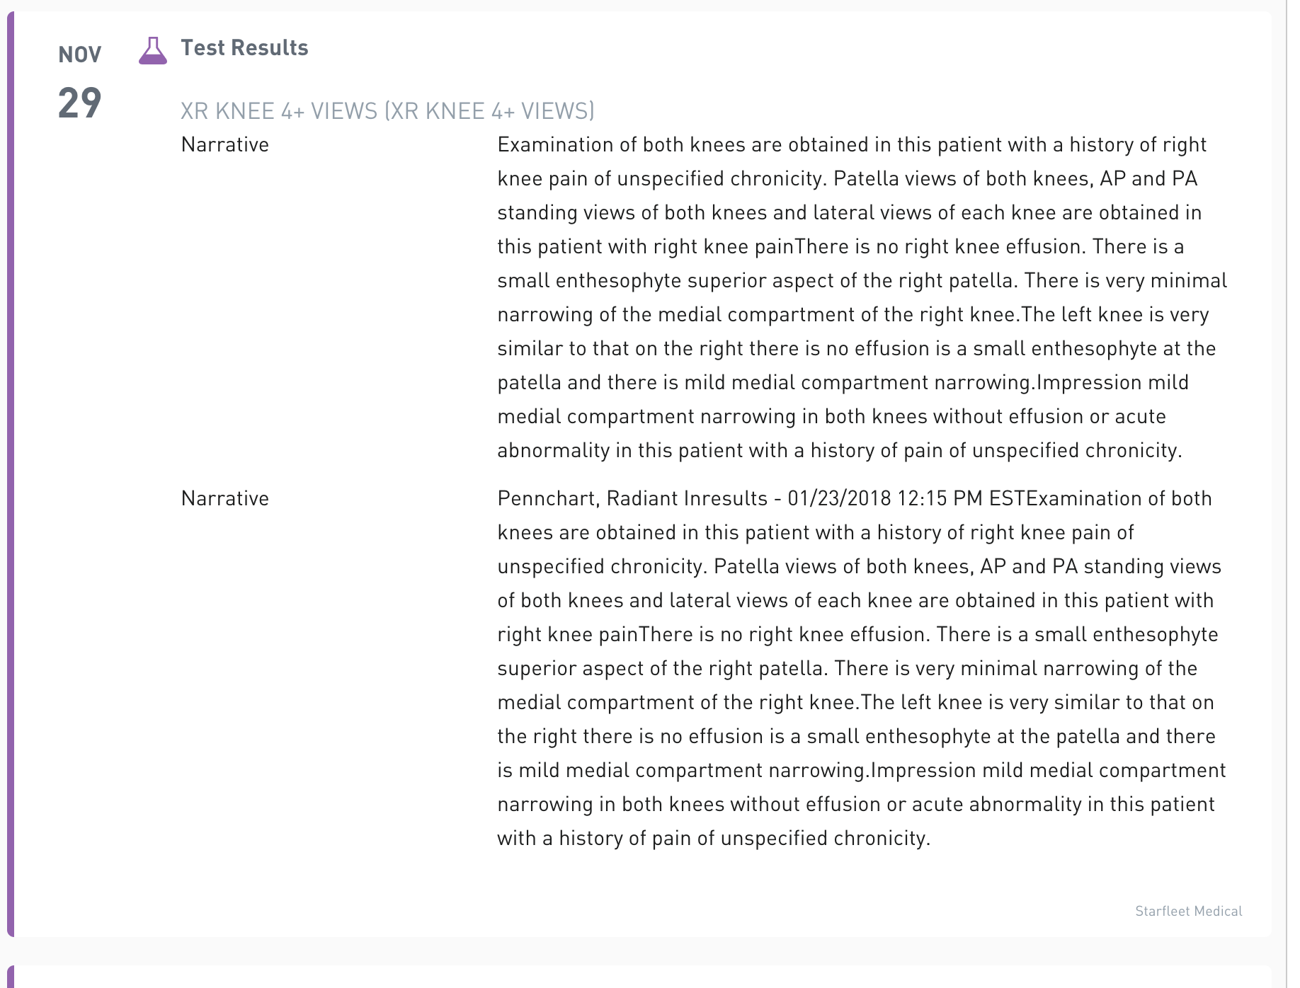
Human API Data: Portal Timeline

Slide 28
Human API Portal

Slide 29

Connect and view data with no integration
Use the Human API portal to manage user data acquisition and enable users to connect their health data all without writing a single line of code.
Or, weave the Human API experience directly into your own application, or outreach.

Slide 30
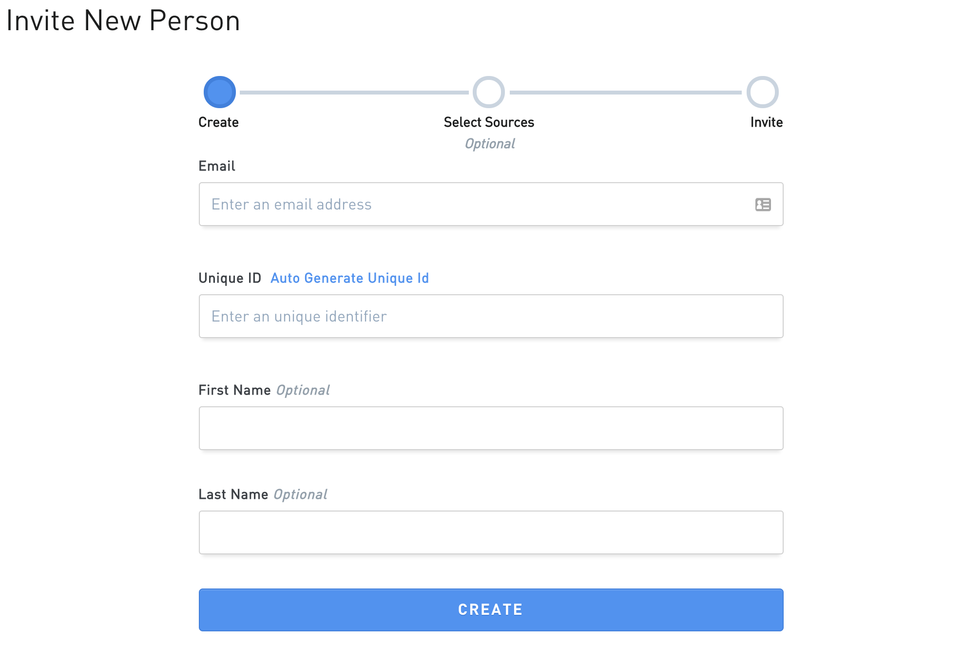
Easily invite consumers to connect data
Create links for consumers to easily access and connect their data.
Customize the experience by pre-seeding the health care provider you would like to access.
View the status of a connected users.

Slide 31
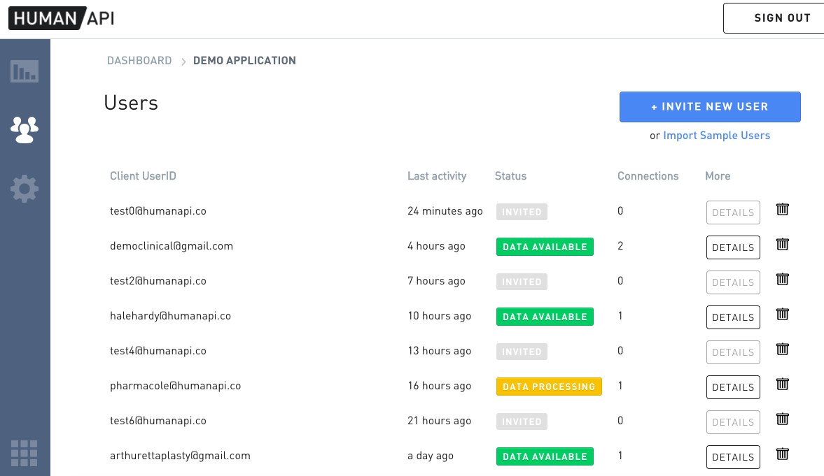

Slide 32
MyHuman API

Slide 33
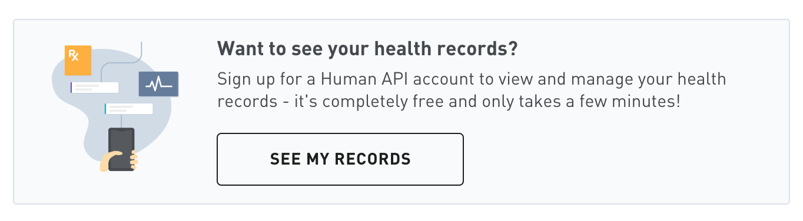
MyHumanAPI: Transparency and Engagement
- Provide transparency
Improve engagement
Offer a new differentiated experience to customers
Help customers take control of their health

Slide 34
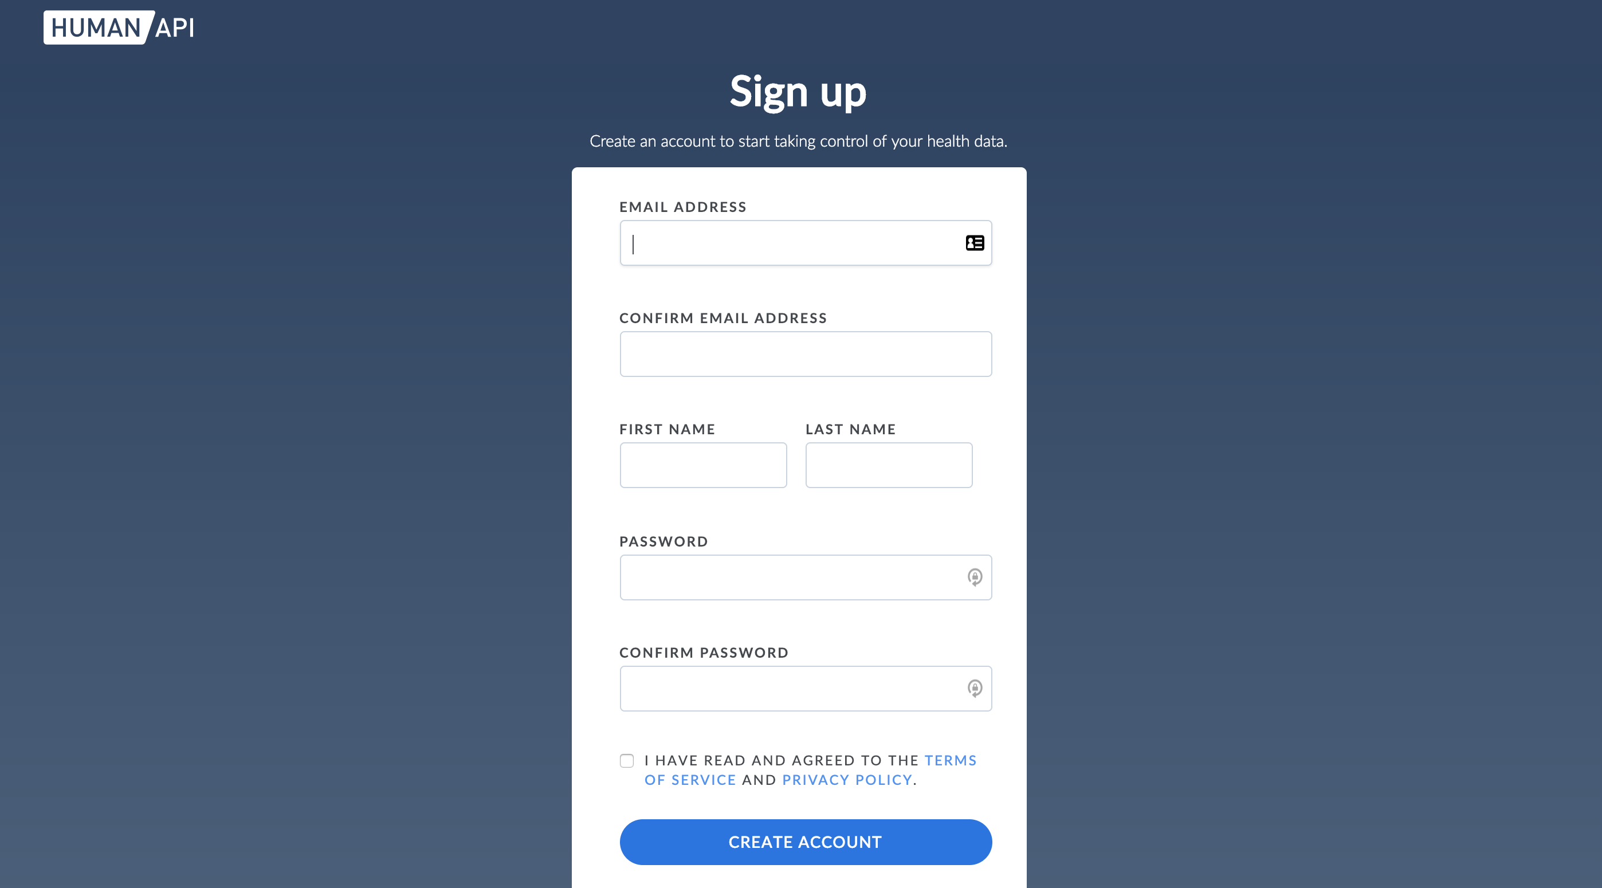
Proposed insureds and policy holders can easily view and collect their health data by signing up for a free MyHumanAPI account after sharing data with a carrier.

Slide 35
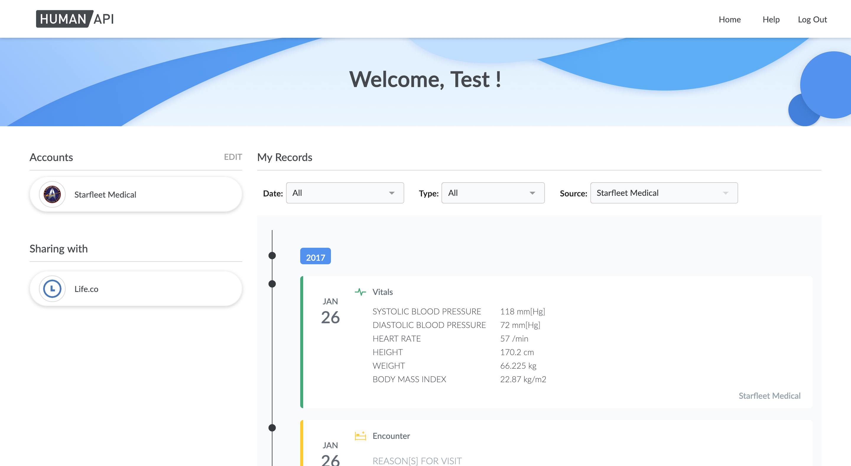

Slide 36
Getting Started

Slide 37
Documentation & Collateral
To get started, provide the email addresses of the people you want to administer your application and Enterprise Portal, as well as the data source types you want to evaluate, to your Human API contact.
Human API will then create your portal account and send invitation emails. From there you can invite end-users to connect their data from within the Portal and/or start integrating Human API Connect into your application.
Our user experience
Our Data Network
Our Data
Fictional sample data: Sample data for a handful of fictional users in PDF, CSV, & JSON format. Includes documentation regarding the data organization as well as schema and sample scripts for putting Human API data into CSV format and/or loading into a relational database.
(Note: this is the data for the same fictional accounts that can be used when testing a Connect integration or the Human API Enterprise Portal)

Slide 38
Developer Resources
Enterprise Portal: Log in to manage your application(s)
Developer documentation: All documentation required to integrate Human API
API documentation: API documentation and example structured data
If you’d like to test retrieving data directly from the API for connections created through the Enterprise Portal, follow these instructions using the unique ID you used to create the invitation.
If you're planning to provide developer access to do test an integration with your own application(s), get started by looking through our guide to integrate the authentication flow.

Slide 39
Testing
For frontend testing for either a direct integration or via the Enterprise Portal, you can use the fictional accounts described at the bottom of this page.
For a direct integration, you can integrate notifications once the auth flow is confirmed to be working

